Slide 1
Learnings From the Articles of Digital Entrepreneurship
Dr. S. K. Majumdar

Slide 2
Salient Points of Article 1
This Article answer One Critical Question:
Why many Startups fail to Scaleup?

Slide 3
Salient Points of Article 1
According to author: Many Startups fail to see the Big Picture.
Please point out to students that Startups often fail in Enterprise Building phase (Show the LMDE)
According to Author They fail to:
Set Meaningful Goals
Formulate Strategy to Achieve the Goal
Execute the set Strategy

Slide 4
Lifecycle Model of Digital Entrepreneurship
Driving
Innovation
Radical
Process Innovation
Design Thinking
The Iterative Front End of Digital Entrepreneurship
Concept
Business Development
Platform
Innovation
Design Criteria
Prototype
Market Entry
Idea
Digital
Platform
Enterprise Building
Customer
Discovery
Customer
Winning
Business Model Actuation
Building STAR Teams
Realigning TEAM with Growth Strategy
Vibrant Digital
Enterprise
Product/ Service Development
Business Model Development
Fight Rivalry
Sustain Growth
Platform
Up-gradation
Fuzzy Front
End of Design
Pivoting
Digital Process
Back End of Digital Entrepreneurship
S = Strategic
T = Transformational
A = Agile, and
R = Responsive
T = Task, Talents and Executive Leadership
E = Engagement and Exploration
A = Alignment and Accountability
M = Measurement and Management
Digital Ecosystems
Innovation to Orchestration to Value Optimization
Source: Dr. S. K. Majumdar

Slide 5
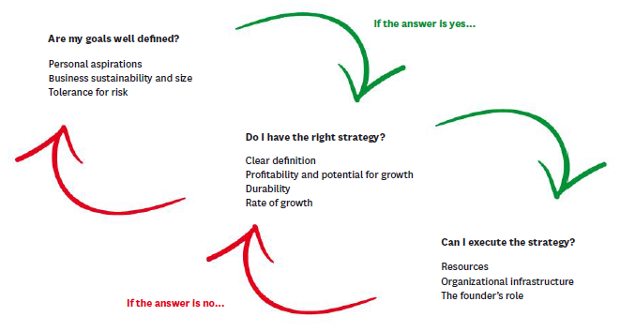
Entrepreneur’s Guide to Big Issues

Slide 6
Why it happens?
Innovators and Entrepreneurs lack Corporate Management Skills
They often fail to Delegate and take back seat
Answers can be find in Article 2

Slide 7
Salient Points of Article 2
This Article answer One Critical Question:
What are the innate quality/ abilities of an Entrepreneur?

Slide 8
Salient Points of Article 2
According to author: True Entrepreneur should have:
Humility
Understand People’s Willing to Pay (WTP) for what? How much? and Why?
Passion for Tinkering / Playing/ Repairing
Lesions from Past does not apply
Support is Essential be it family or friend

Slide 9
Salient Points of Article 2
According to Author an Entrepreneur must:
Be a Careful Spender
Avoid Ego Trap (Cut the ‘E’ let it Go)
Understand His/Her True Talent (What you are good at and what you love to do?)
Be Prepared Do Hard Work
Understand that you are not your business. Your company’s success or failure does not reflect your worth as a person.

Slide 10

Thank You

